Slide 1
Student Growth update 2014-2015

Slide 2
Learning goals for today
-Teachers will be able to clearly delineate between the 4 levels of expectations on student growth goals for the state.
- Select the group of students they are going to focus on for 2014-2015

Slide 3
Workshop Schedule
10/2/14- What do Student growth goals have to have and who will I target?
10/9/14- What standards do I need to align my student growth goals to this year?
10/16/14 How much growth do I need to demonstrate?
10/23/14- What are the possible sources of growth I can use?
How do I demonstrate these?
10/30/14 What are some possible strategies to reach these goals in my content?

Slide 4
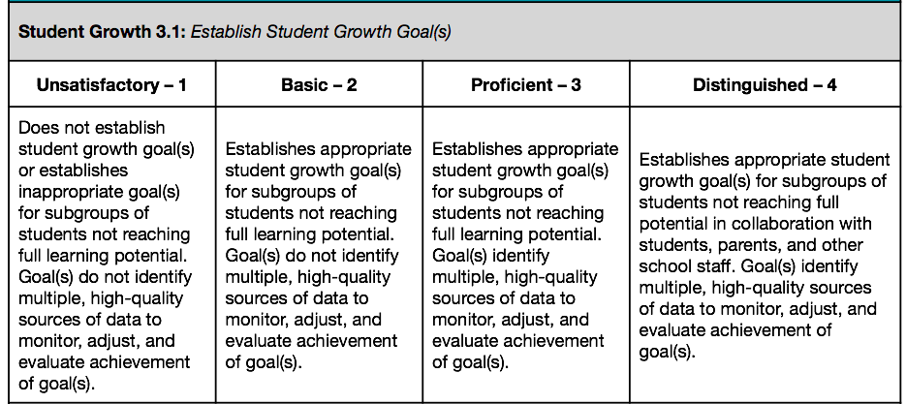
State laws and expectations

Slide 5
Evidence of growth 3.2

Slide 6
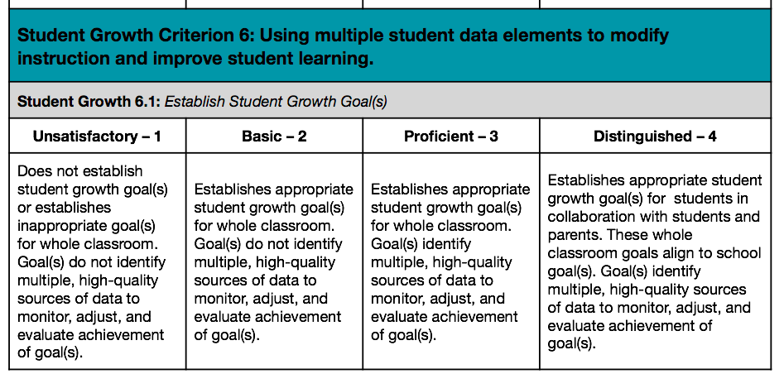
Criteria 6.1

Slide 7
Evidence 6.2

Slide 8
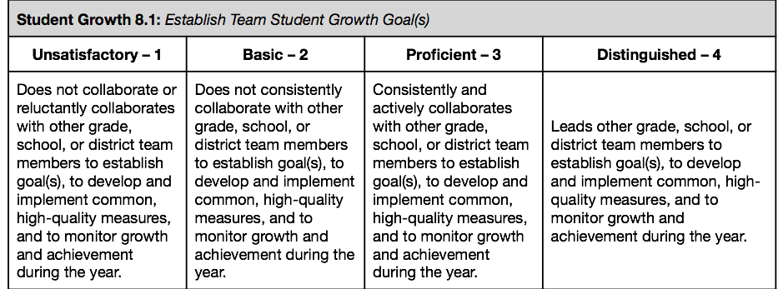
Criteria 8

Slide 9
Have to be SMART Goals
Specific to the content area or standard
Measurable with multiple assessments
Assignable to a specific group of students
Realistically state results that are achievable but still demonstrate growth
Timely in giving at least two data points to show growth

Slide 10
Step one
Criteria 3-.1
• For those who teach more than one class, which class will be your focus?
• Which students in this class are not meeting full learning potential?
• Why are these students your priority for this instructional period?
Which big idea is supported by the learning goal?
• Which content standards are associated with this big idea?
• Why is this learning goal important and meaningful for these students to learn?
• In what ways does the learning goal require this group of students to demonstrate deep understanding of the knowledge and skills of the standards or big idea being measured?
• Identify the instructional period for the learning goal (e.g., benchmark period, fall to spring, one semester) and why this time span is appropriate and sufficient.
Learning Goal(s): A description of what students not meeting full learning potential (i.e. achievement/opportunity gaps, ELL, special education, highly capable) will know/be able to do at the end of an instructional period based on course- or grade-level content standards and curriculum.

Slide 11
6.1
Which big idea is supported by the learning goal?
• Which content standards are associated with this big idea?
• Why is this learning goal important and meaningful for these students to learn?
• In what ways does the learning goal require this group of students to demonstrate deep understanding of the knowledge and skills of the standards or big idea being measured?
• Identify the instructional period for the learning goal (e.g., benchmark period, fall to spring, one semester) and why this time span is appropriate and sufficient.

Slide 12
8.1
Establish plans for collaboration to develop and implement common, high quality measures, and monitor growth for a group of students the instructional team teaches in common.
Which teacher(s) will you collaborate with to improve student growth?
• How will your instructional tea !decide which students to focus on?
• How will your team structure adequate time to develop and implement common high quality measures and to monitor growth during the instructional period?

Slide 13
timeline
August 1-October 20- Beginning assessments : MAPS, DIAGNOSTIC, CLASSROOM
October 31- Student growth goals inputed into eVal
May 1- Student growth evidence and artifacts due in eVal

